Slide 1
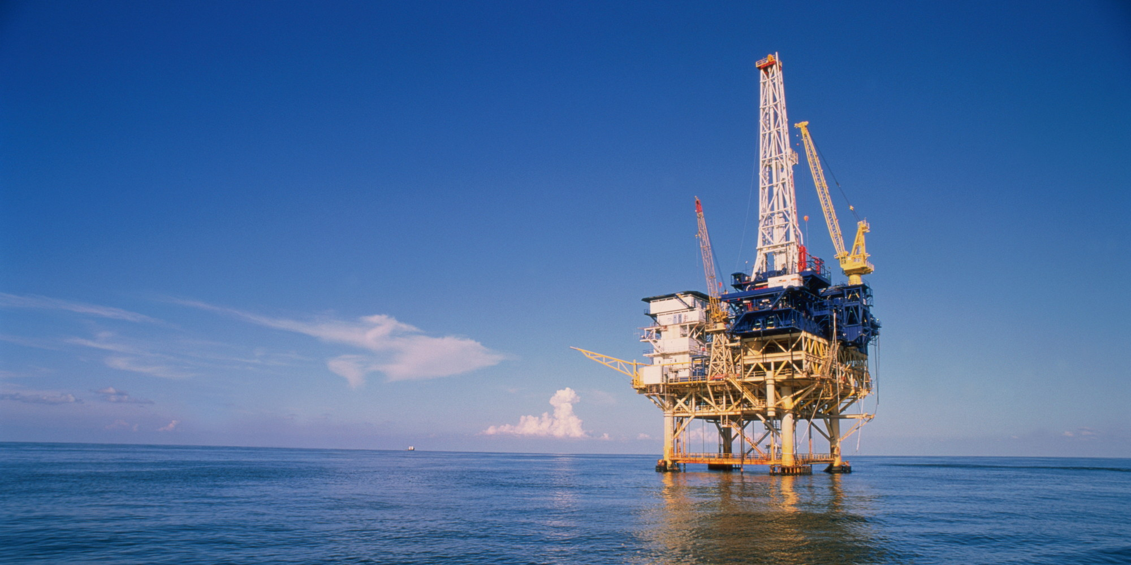


Shell VS Total
ACCT 202 2017 WINTER
Tiffany Gwyneth Tiono
Steven Nash
Xiezi Zhang
Xiaoqi Gu

Slide 2
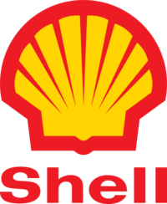
At first, we picked
Operates in 70+ Countries
Serves 5,000+ gas stations in USA
The 6th largest oil company in the world

Slide 3
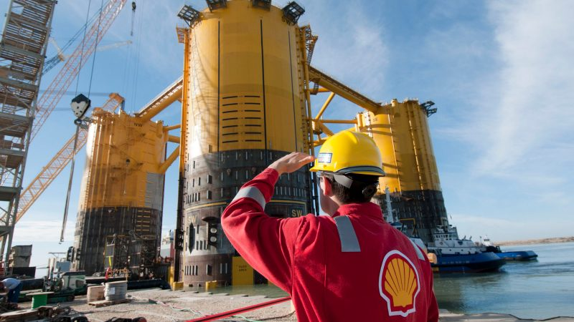
Shell Company
PRICE PER SHARE | MARCH 12 | END OF 2016
SHELL | $51.34 | $54.88
History:. The Royal Dutch Petroleum Company was a Dutch company founded in 1890 and then through the amalgamation of its rival company: Trading Company Ltd of the United Kingdom, created the Royal Dutch Shell Group in February in 1907.
Services: Upstream International
Upstream Americas
Downstream
Projects and Technology
Goals : More and cleaner energy
0

Slide 4
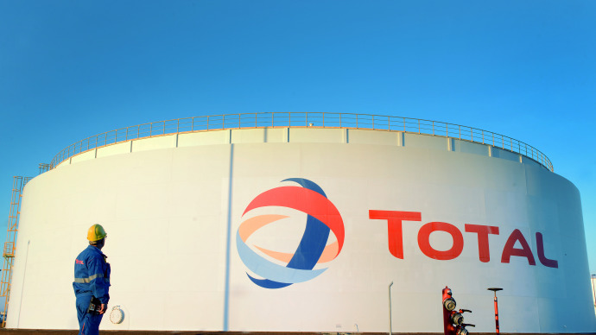
Total Company
PRICE PER SHARE | MARCH 12 | END OF 2016
TOTAL | $50.25 | $50.97
History: Total is one of the most famous French multinational integrated oil and gas company in the world and one of the seven “Supermajor” oil companies all over the world. Total founded on 28 March 1924, as the Compagnie française des pétroles (CFP), which means the "French Petroleum Company”.
Services : Oil and gas development, mined and refined, distribution and distribution, oil and refined petroleum products marketing and trading, etc, in international reputation.
Target: Provide affordable and sustainable energy to solve the challenge of climate change then support social and economic development worldwide.
It is based in Houston, Texas in USA.
3

Slide 5
Income Statement
2014
0

Slide 6
Income Statement
2015
Increase (decrease) : (86.8)% SHELL
Increase/ (decrease):(79.3)% SHELL
Increase / ( decrease): (75.5)% SHELL
Increase (decrease): 15.5% TOTAL
Increase (decrease):77.5%. TOTAL
Increase ( decrease): 18.5% TOTAL
0

Slide 7
Balance Sheet 2014
0

Slide 8
Balance Sheet 2015
Increase (decrease) : (31.2)% TOTAL
Increase (decrease) : (4.8)% TOTAL
Increase (decrease) : (65.1)% TOTAL
Increase (decrease) : (37.5)% SHELL
Increase (decrease) : 13.8% SHELL
Increase (decrease) : (16.8)% SHELL
0

Slide 9
Investing and Financing Activities
Cash flow information |  |  | $ billion
Year | 2015 | 2014 | 2013
Cash flow from operating activities | 29.8 | 45.0 | 40.4
Net cash used in investing activities | (22.4) | (19.7) | (40.1)
Net cash from/(used in) financing activities | 3.8 | (12.8) | (9.0)
Increase/(decrease) in cash and cash equivalents | 10.2 | 11.9 | (8.9)
Cash and cash equivalents at the end of the year | 31.8 | 21.6 | 9.7
Cash flow from operating activities | 19.9 | 25.6 | 28.5
Net cash used in investing activities | (20.4) | (24.3) | (28)
Net cash from/(used in) financing activities | 0.1 | 0.59 | (0.15)
Increase/(decrease) in cash and cash equivalents | (1.43) | 4.9 | (1.1)
Cash and cash equivalents at the end of the year | 23.67 | 25.1 | 20.2
0

Slide 10
Investing and Financing Activities
Shell Acquired BG Group, a UK based oil and gas producer, for about $50 billion. BG is an industry leader in liquefied natural gas.
Shell recently has agreed to sell a package of oil and gas fields located in the North Sea to Chrysaor Oil for $3.8 billion.
Shell announces the final investment decision (FID) to advance the Appomattox deep-water development in the Gulf of Mexico.
Total announced last December that they are acquiring around 23% of Tellurian Investments for 207 million dollars.
Total Energy Ventures, the venture capital arm of French energy company Total, is investing in Aquion Energy, a start-up specialized in energy storage technology.
Total sells North Sea midstream assets for $711 million
0

Slide 11
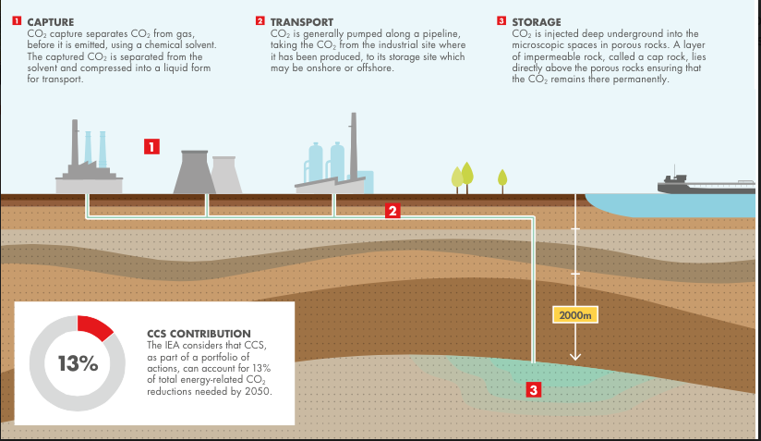
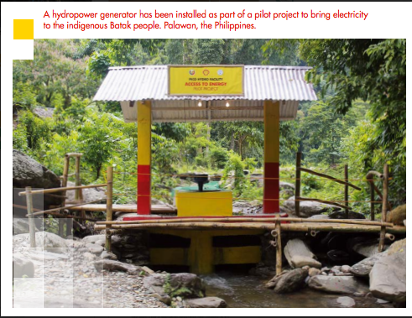
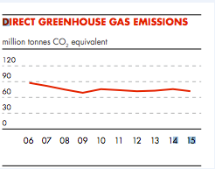
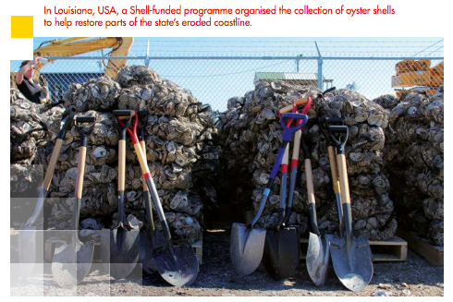
Corporate Social Responsibility
In 2015 they spent close to $100 million on community development, disaster relief and education.
Shell Spent close to $22 million in 2015 obstructing climate change regulations through lobbying and political contributions.
Shell’s subsidiary company Quest Canada has reduced emissions by 315 kilotons using innovative carbon capture technology
0

Slide 12
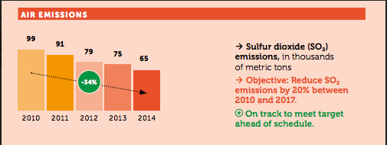
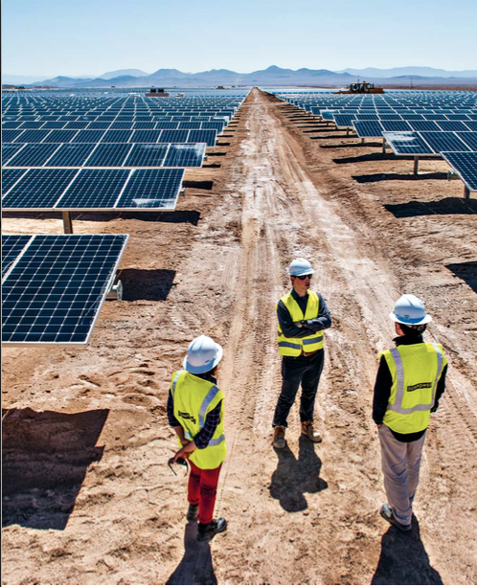
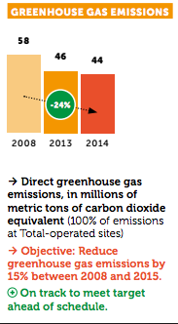
Corporate Social Responsibility
Total has reduced their greenhouse emissions by 24% since 2008 by increasing the efficiency of their operations
Total’s affiliate company SunPower’s solar power plant in Chile generates enough power for 70,000 homes
Community development spending was up to 459 million Euros in 2014
0

Slide 13
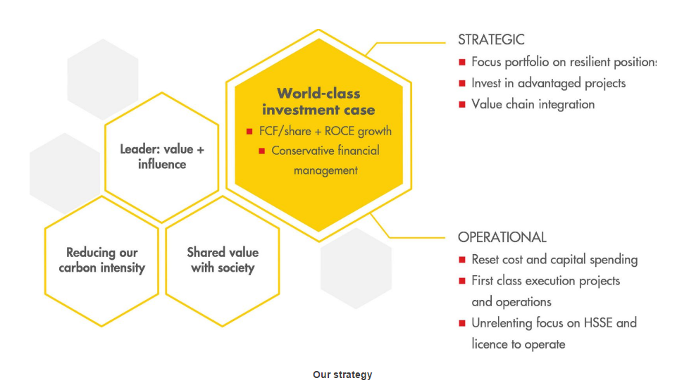
Shell's strategy
Shell's strategy seeks to strengthen our leadership in the oil and gas industry, while positioning the company for growth as the world transitions to a low-carbon energy system. Safety and environmental and social responsibility underpin our business approach.
Growth priorities
Deep-water oil and gas and Chemicals are Shell's growth priorities. They should become the
cash engines in the next decade, with expected improved returns and cash flow from around
2020 as growth investment flows through into production. We are developing deep-water
fields in Brazil and the Gulf of Mexico, and Chemicals projects on the US Gulf Coast,
Pennsylvania and in China.
0

Slide 14
Total's Prizes Won
Le Revenu 2014 Trophies: Total's Shareholder Relations Department receives the Gold Trophy
Investor Awards 2014 : Total gets the "Communication prize"
Investor Awards 2015: Total gets the “Communication prize”
0

Slide 15
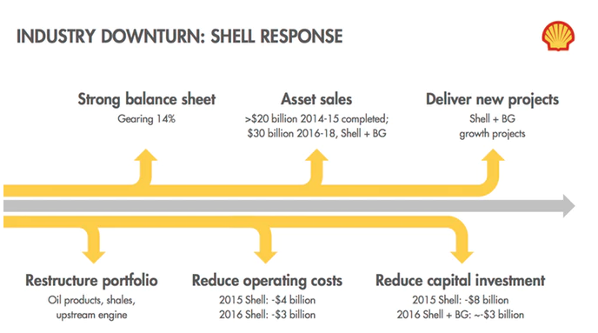
Current Events
Shell has been selling assets as part of its $30 Billion divestment plan. In 2017 it sold Its 50% share in petrochemicals company called SADAF to $820 million.
Shell has come under criticism from environment groups after a 1991 public information film surfaced which indicated the company was aware of climate change years before it took action.
0

Slide 16
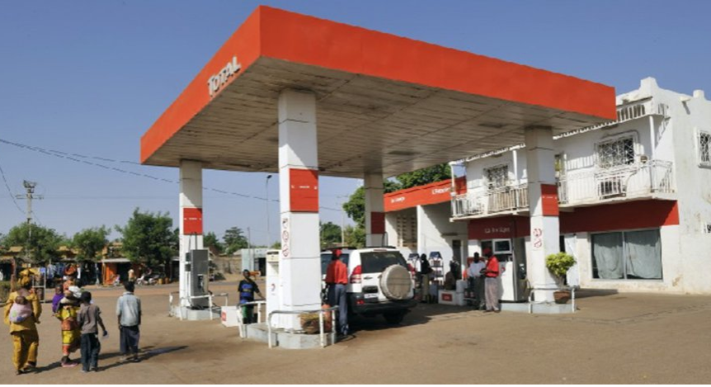
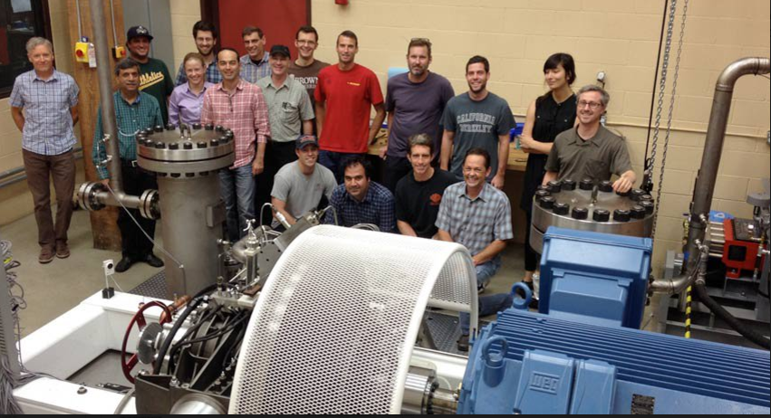
Current Events
In January 2017, Total won an award for corporate investor of the year for its investments in renewable energy start-ups by its venture capital fund called what Total Energy Ventures.
Total has been contributing to the economic development of africa by expanding its retail network which a now has more than 4,200 service stations in 36 countries.
0

Slide 17
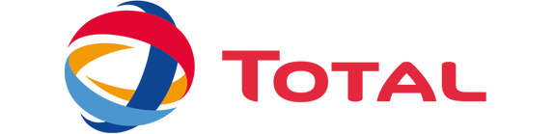
The Winner is
Better Return on Assets
Better Current Ratio
Better Earning per Share
Better communication to investors
Reasonable investing and financing activities
More socially responsible

Slide 18
THANK YOU FOR LISTENING
Q&A Time
Company Overview
Income Statement Items
Balance Sheet Items
Investing and Financing Activities Items
Corporate Social Responsibility Items
Other Items
Current Events

